Slide 1
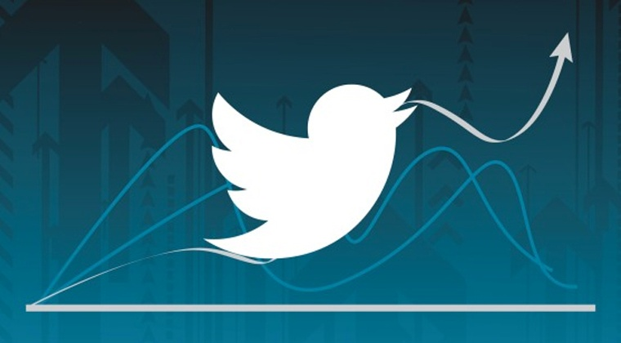
Sentimental analysis of twitter
Name – MANISH Singh NEGI
Section - b
College roll no - 2013377
Class roll no - 31
Semester - 5th

Slide 2
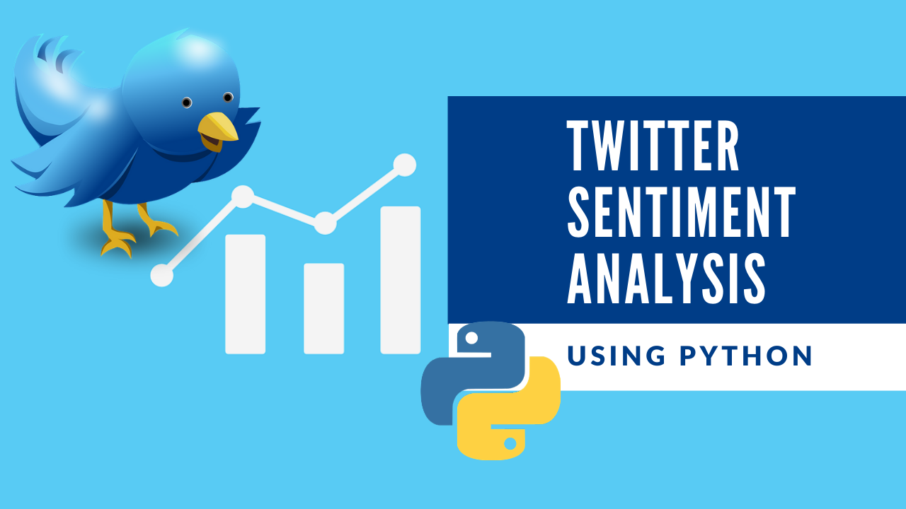
Sentimental analysis
It is the process of predicting whether a piece of information (i.e. text, most commonly) indicates a positive, negative or neutral sentiment on the topic.
Essentially, it is the process of determining whether a piece of writing is positive or negative. This is also called the Polarity of the content.

Slide 3
Why sentiment analysis ?
Business: In marketing field companies use it to develop their strategies, to understand customers’ feelings towards products or brand, how people respond to their campaigns or product launches and why consumers don’t buy some products.
Politics: In political field, it is used to keep track of political view, to detect consistency and inconsistency between statements and actions at the government level. It can be used to predict election results as well!
Public Actions: Sentiment analysis also is used to monitor and analyze social phenomena, for the spotting of potentially dangerous situations and determining the general mood of the blogosphere.

Slide 4
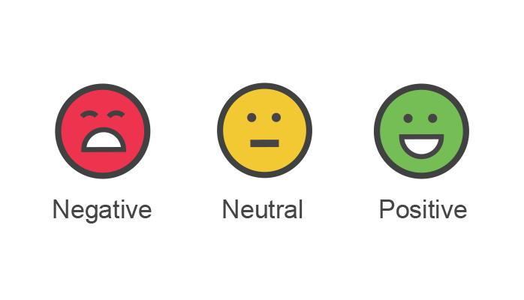
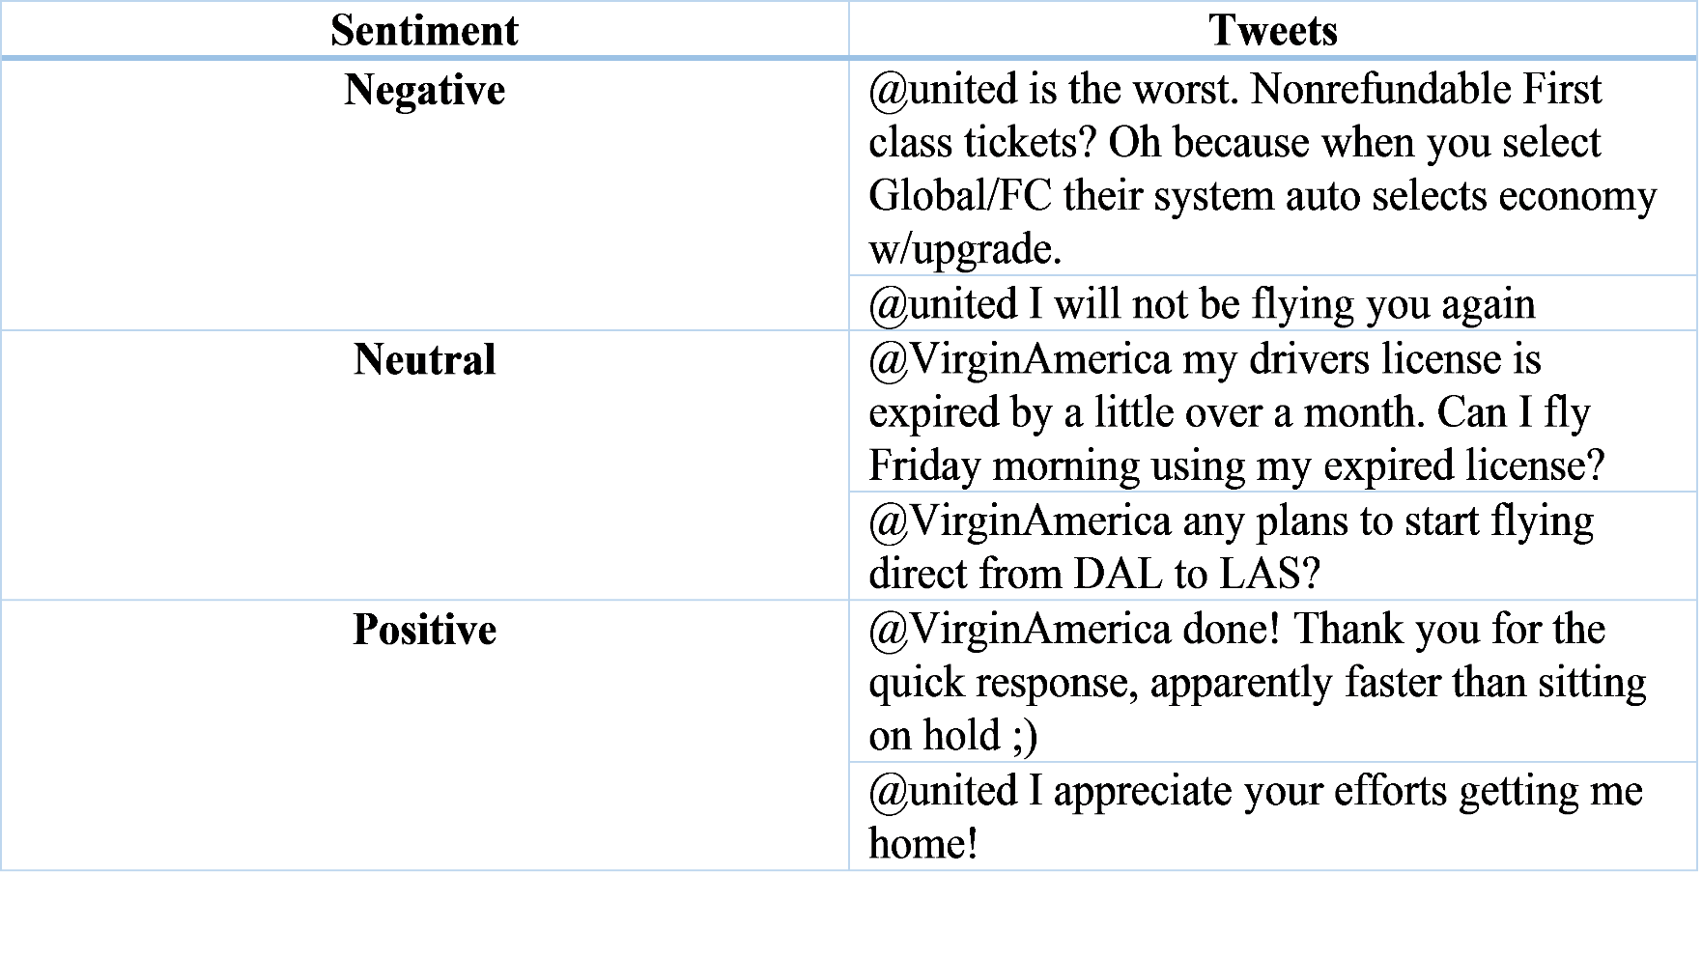

Slide 5
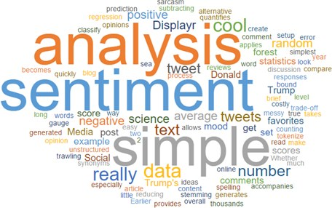
objective
To implement an algorithm for automatic classification of positive , negative and neutral tweets towards the subject of interest

Slide 6
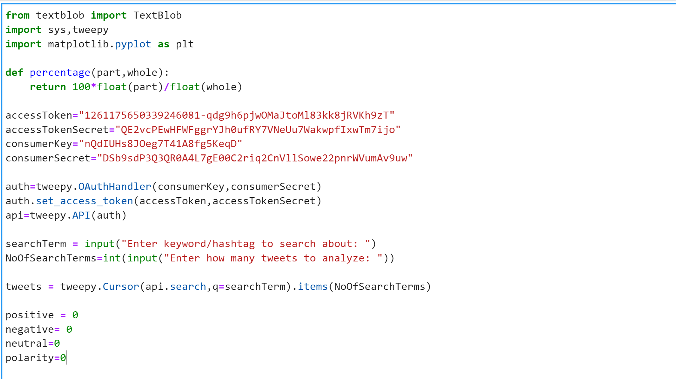
Code snippet

Slide 7
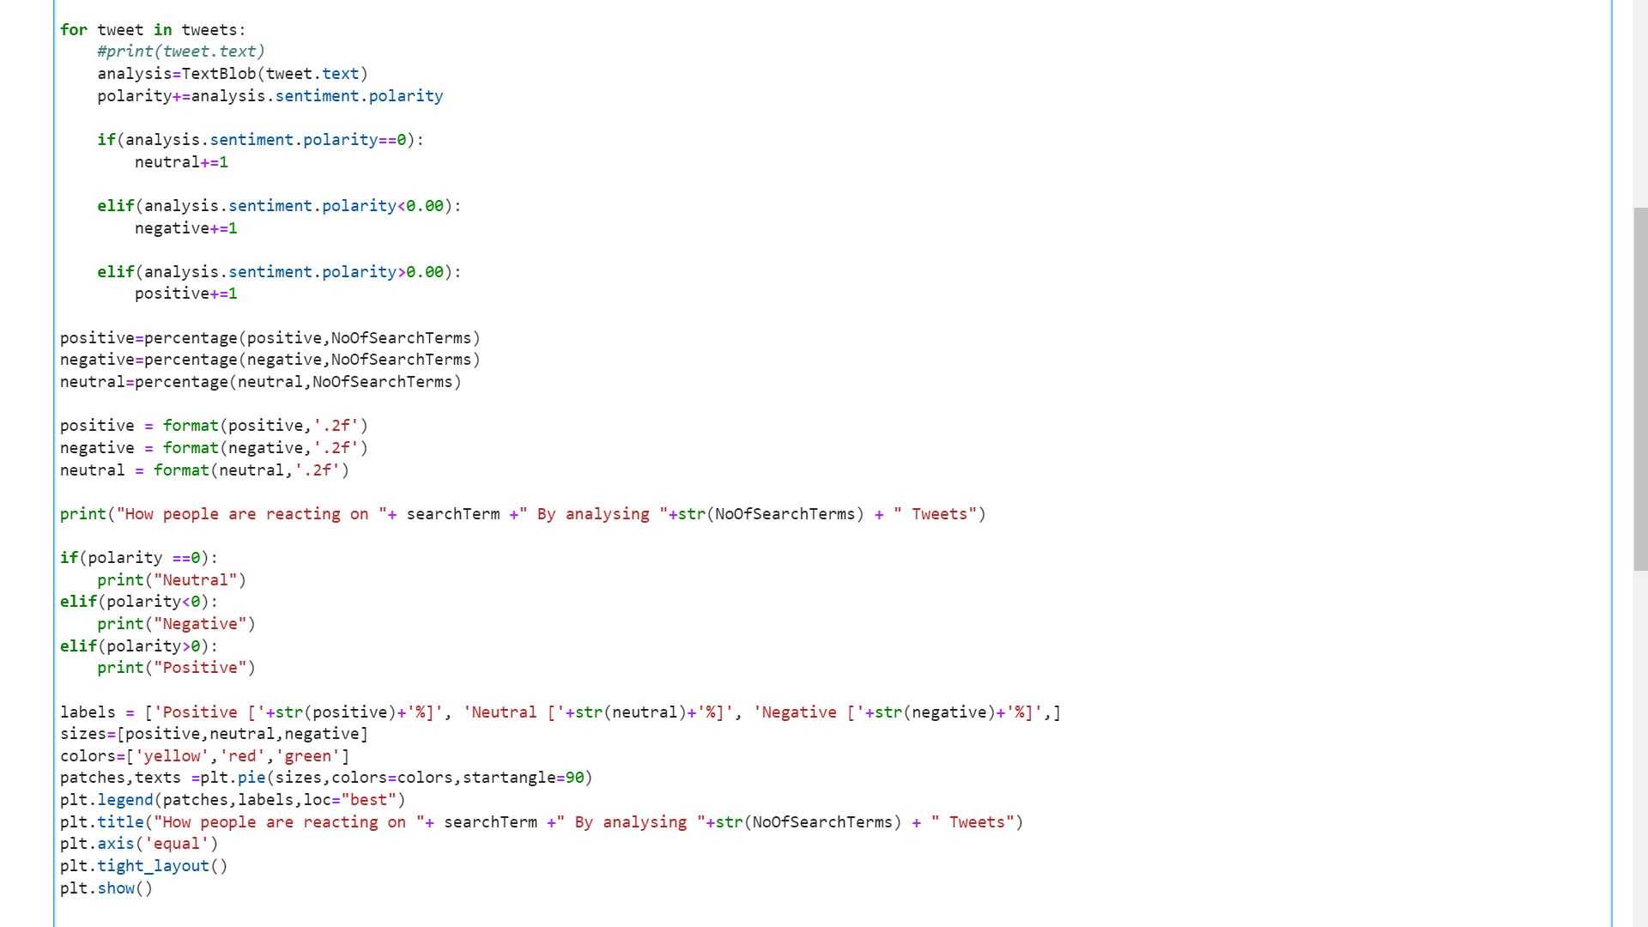
Code snippet

Slide 8
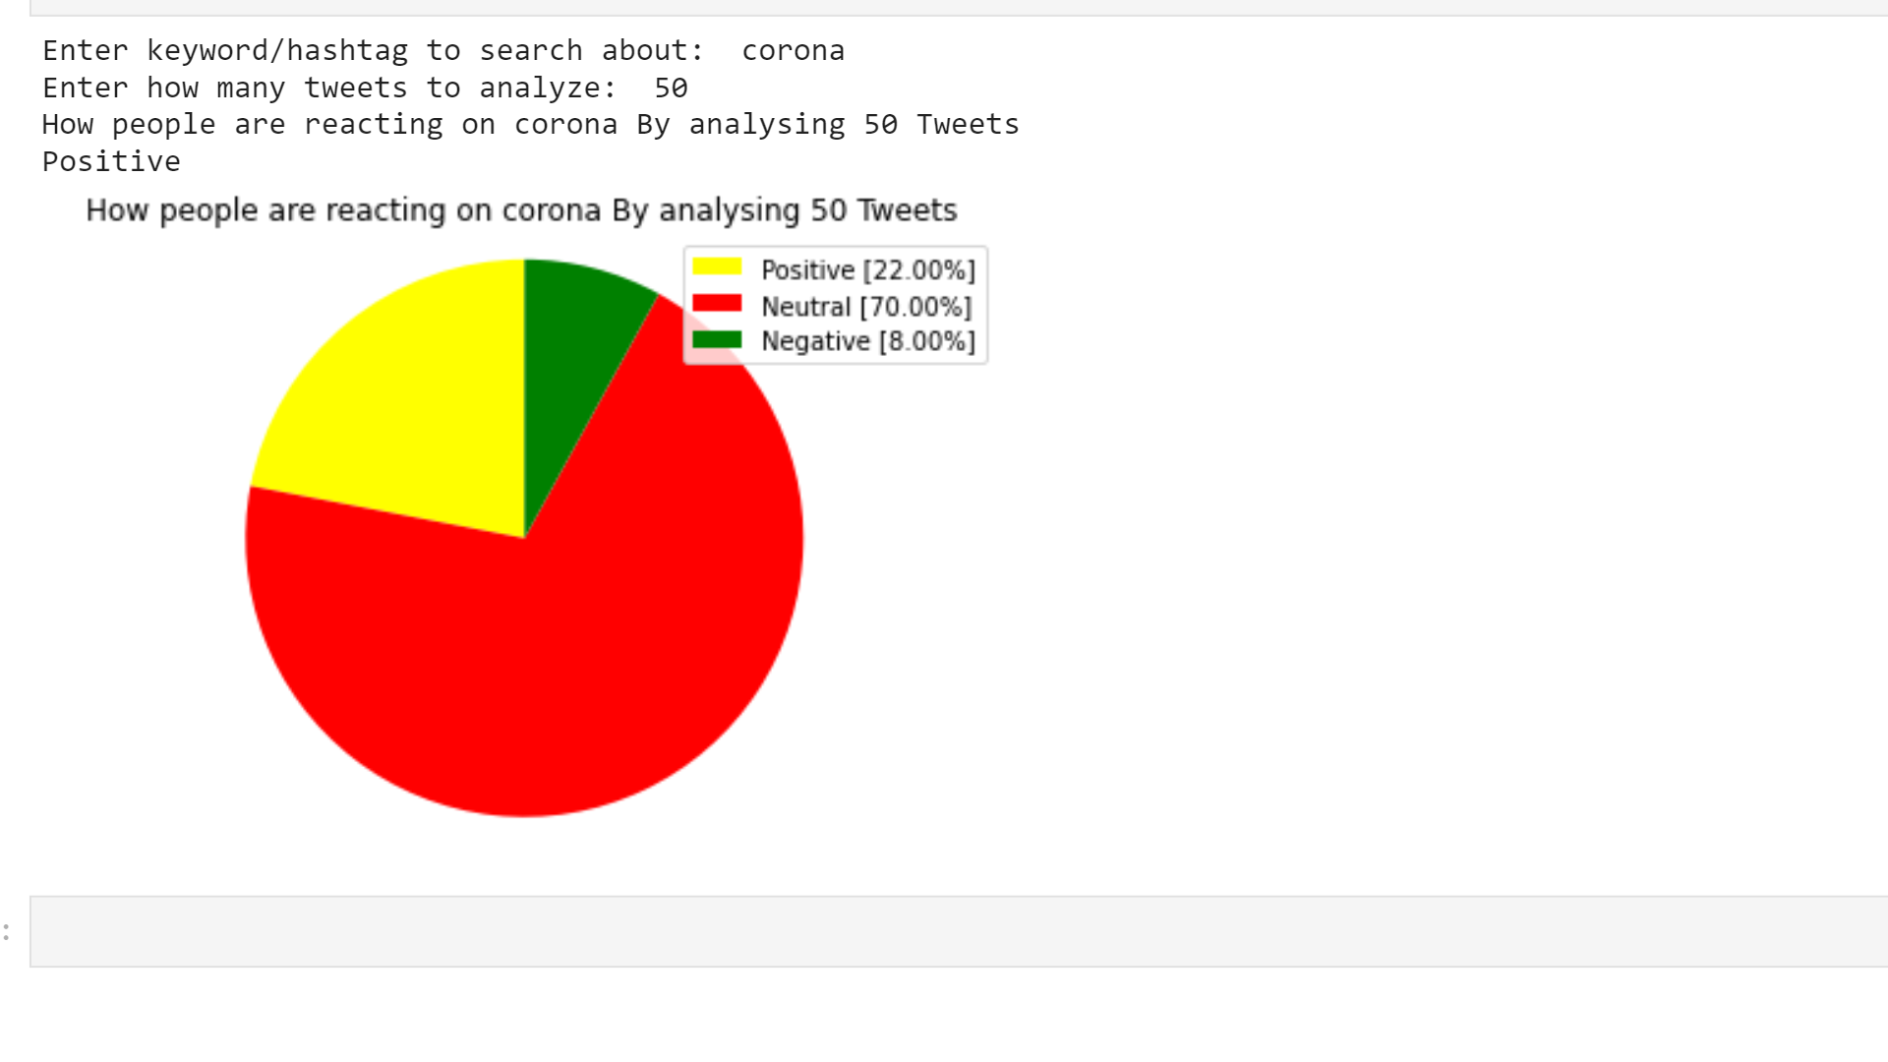
output

Slide 9
Tools used
Language
Python
Python libraries
Tweepy: tweepy is the python client for the official Twitter API.
TextBlob: textblob is the python library for processing textual data.
Matplotlib: is a multi-platform data visualization library built on NumPy arrays.
Sys: Module provides information about constants, functions and methods of the Python interpreter.

Slide 10
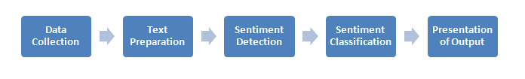
Methodology followed
Data collection
Text preparation
Sentiment Detection
Sentiment Classification
Presentation of Output

Slide 11
What new things learned
What is Sentiment Analysis ?
Why is Sentiment analysis important ?
Sentiment analysis Algorithms
Sentiment analysis challenges
Application and examples of sentiment analysis
Sentiment analysis tools

Slide 12
conclusion
We conclude that using different tools it is easier to classify the tweets and more we improve the training dataset more we can get accurate results.
And in future we look forward to use bigger datasets to improve the accuracy, considering the emoticons and internationalization

